Slide 1




Slide 2




TO-DO APP
PRESENTATION
Presented by Group 1

Slide 3

CONTENT OF THE
TO-DO APP PRESENTATION
Planning
Researching
Sketch of the Design
Designing in Figma
Presentation of the Design
Coding
Checking of the Survey Questionnaire
Survey
Result of the Survey

Slide 4
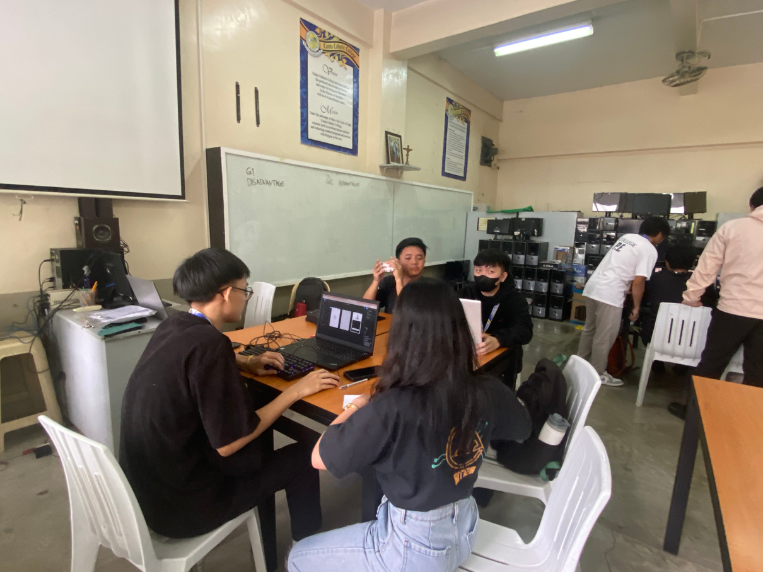
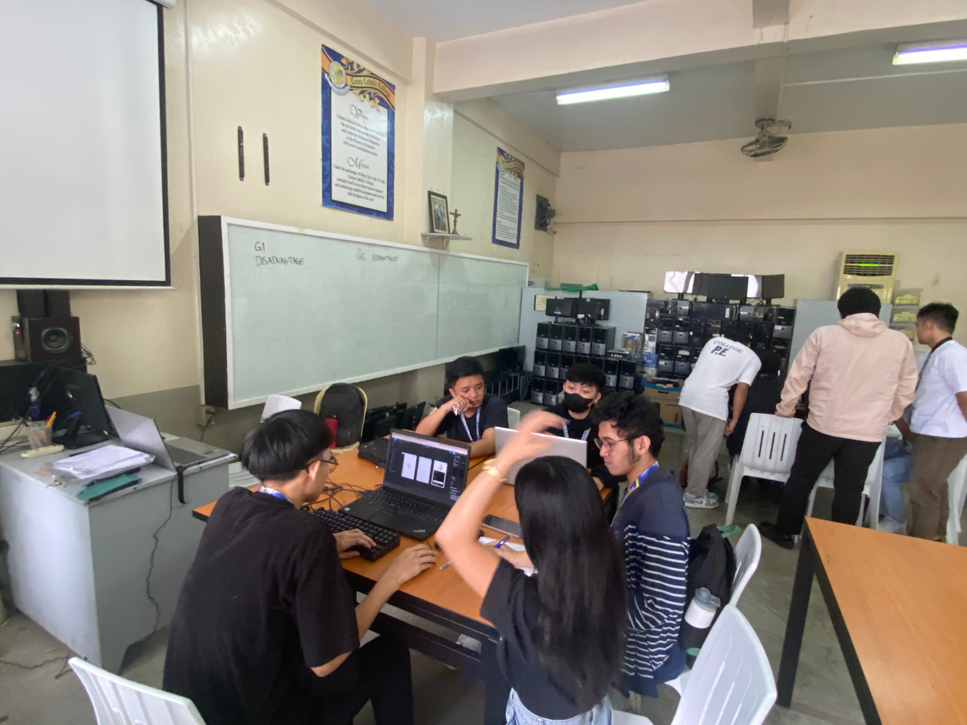
PLANNING

Slide 5
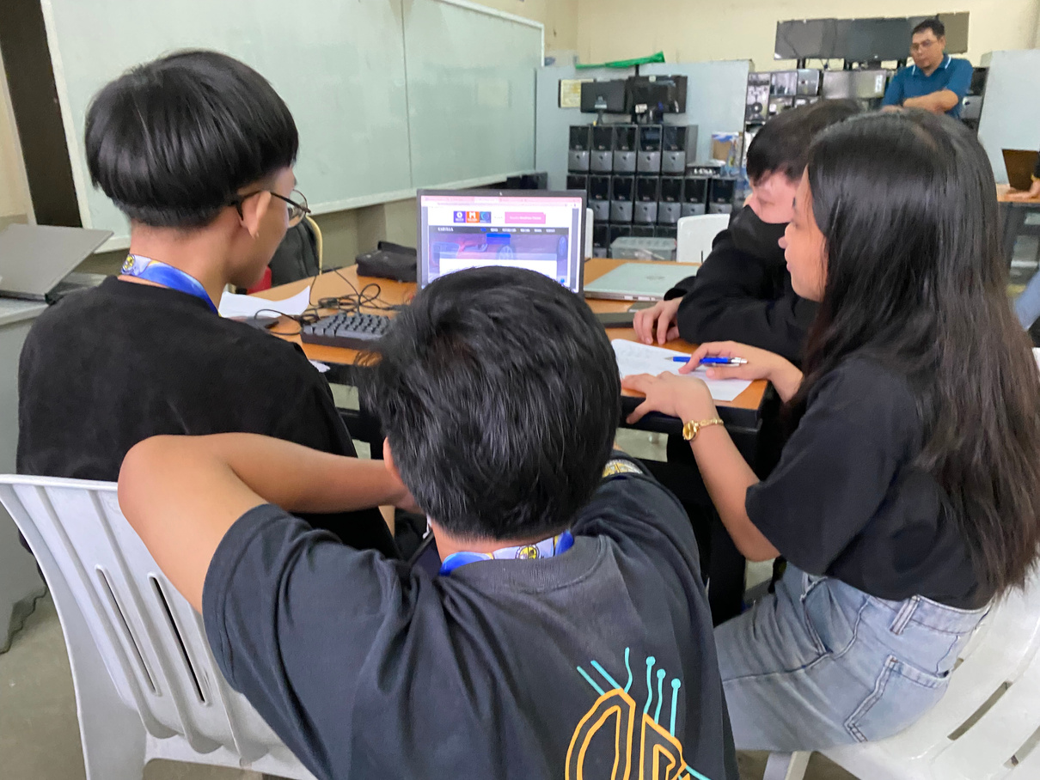
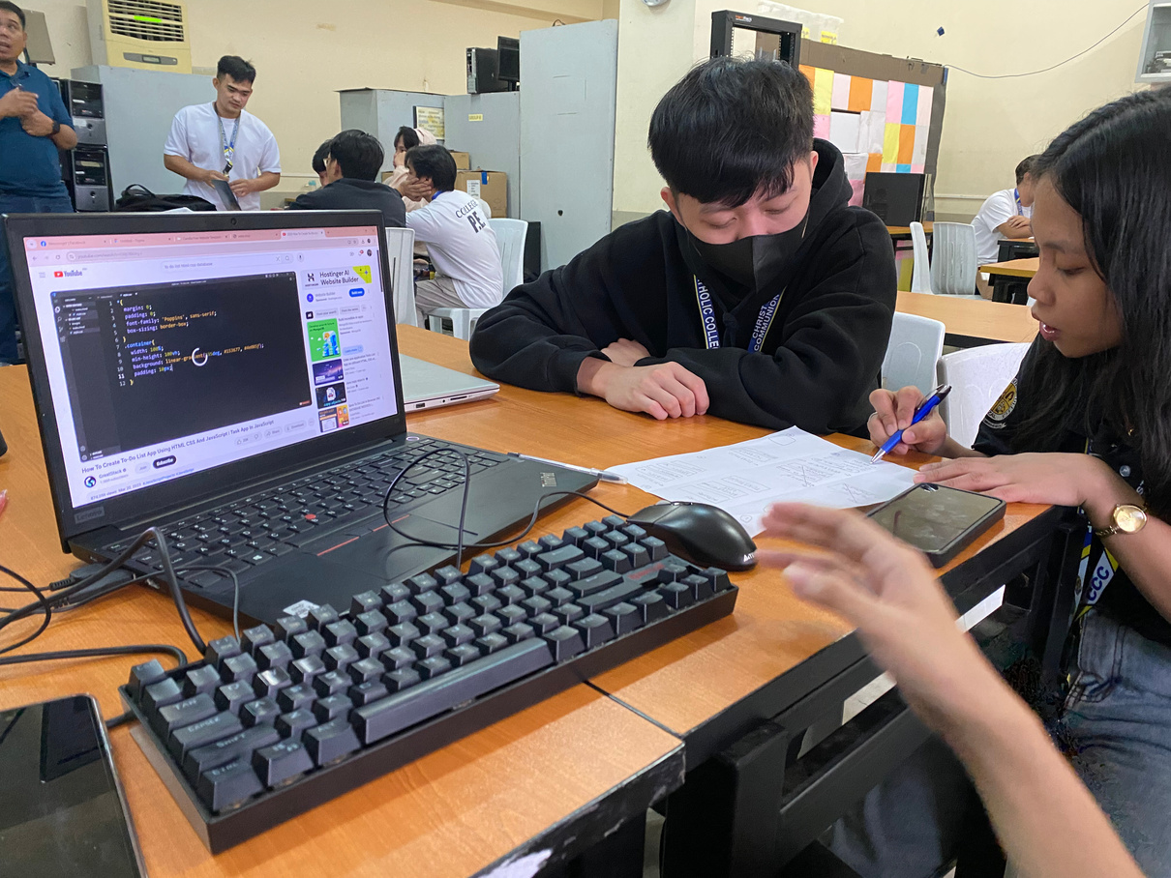
RESEARCHING

Slide 6
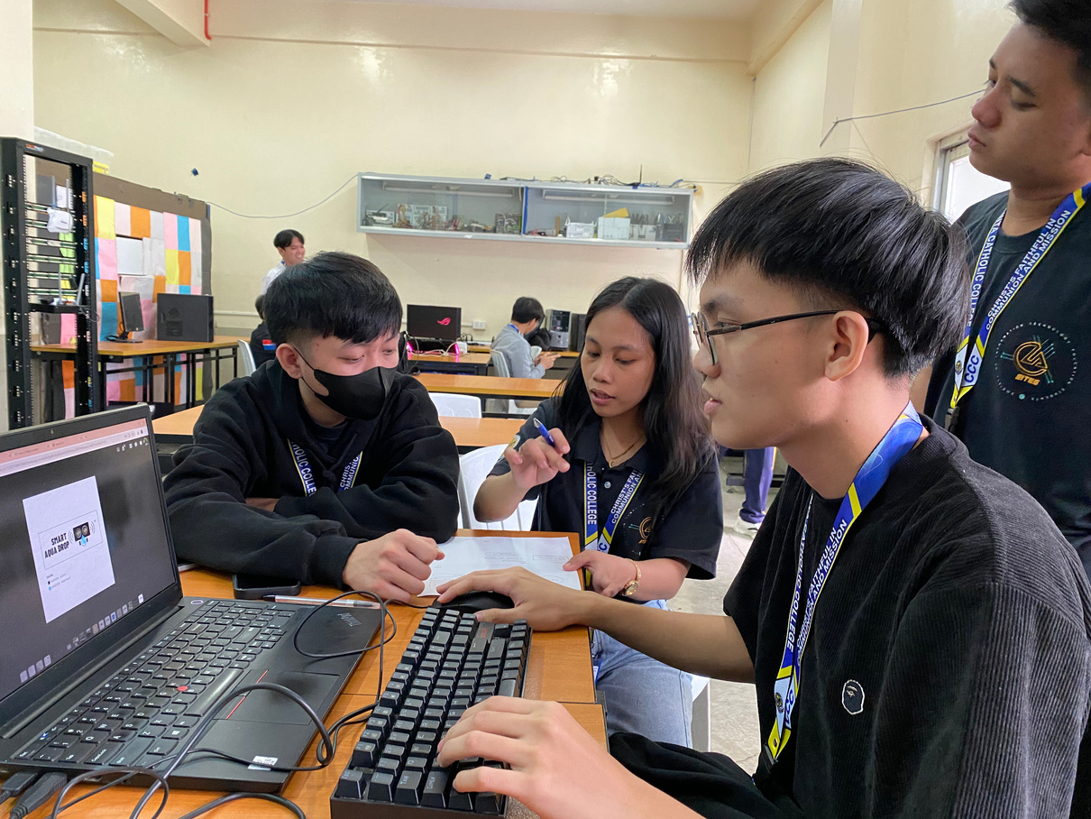
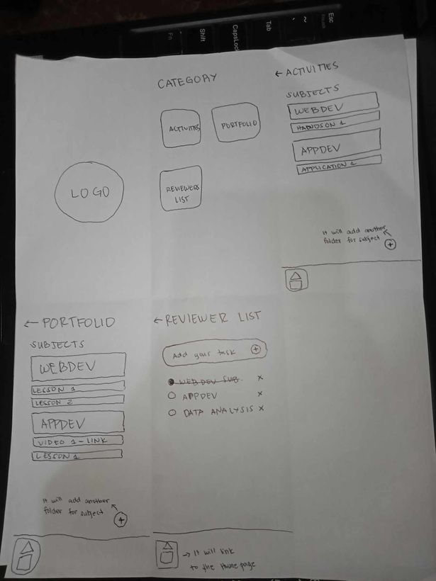
SKETCHING OF THE DESIGN

Slide 7
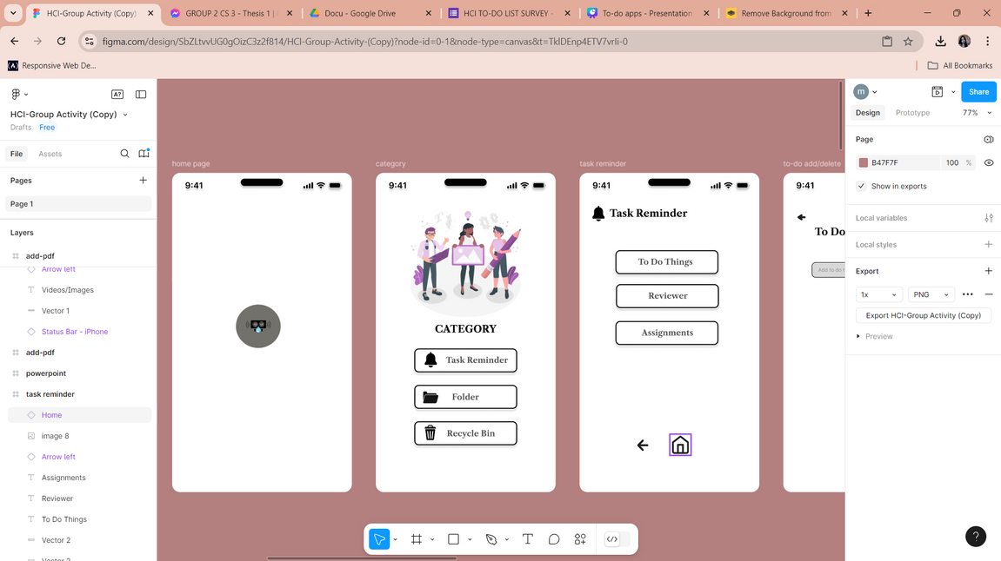
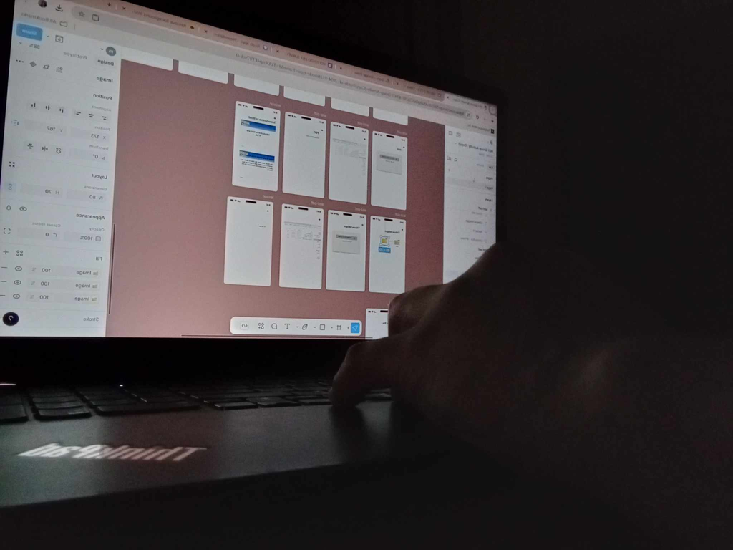
DESIGNING IN FIGMA

Slide 8
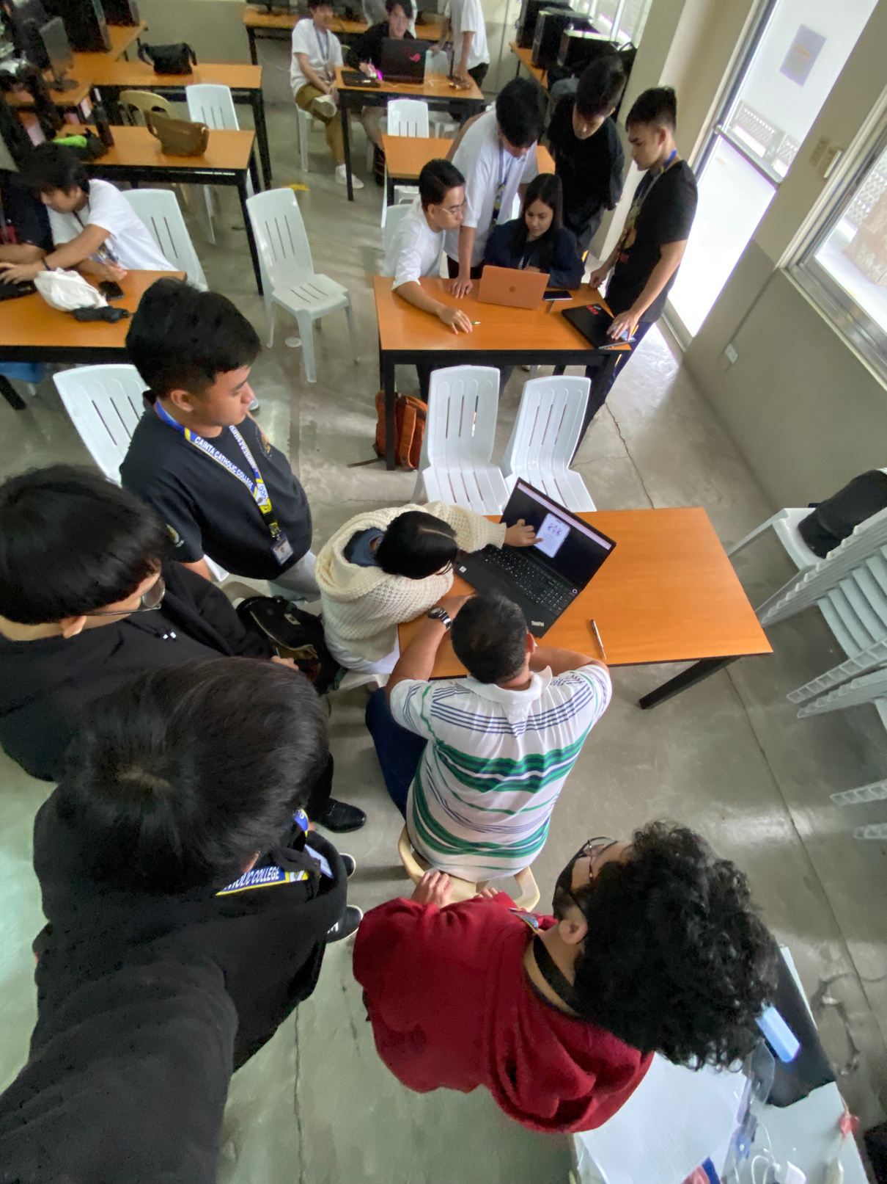
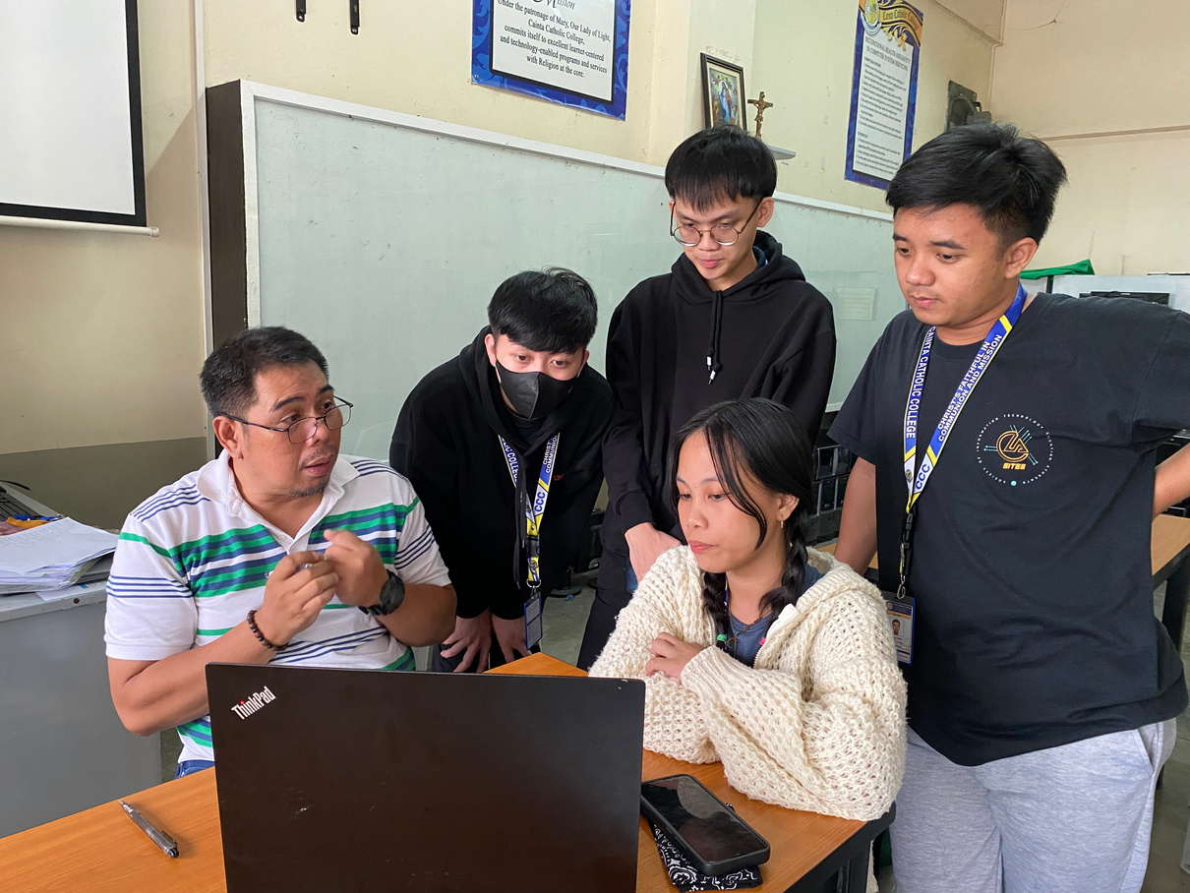
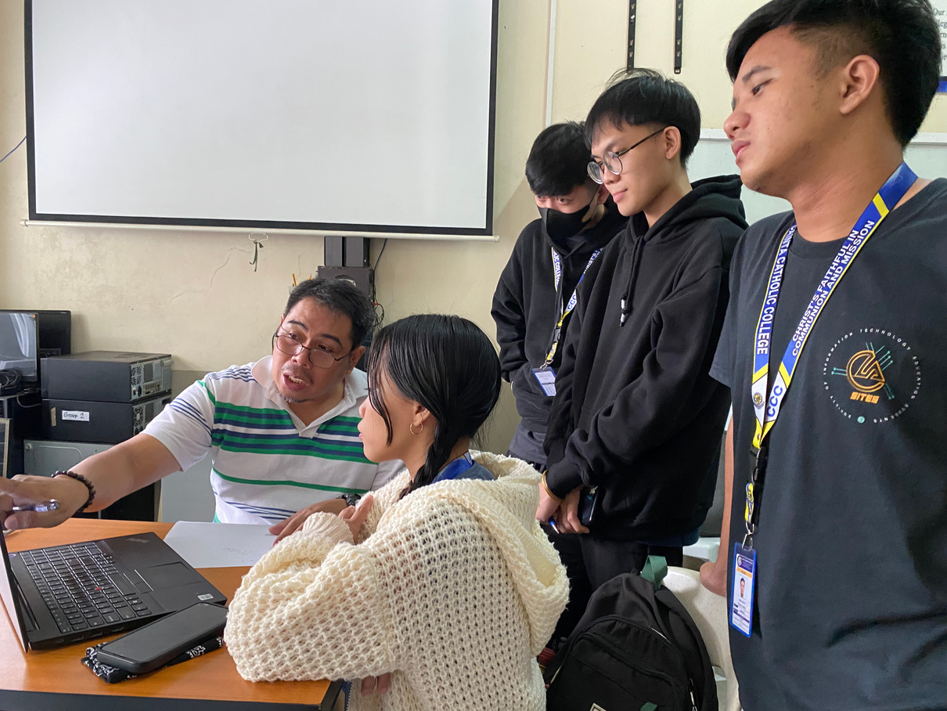
PRESENTATION OF THE DESIGN

Slide 9
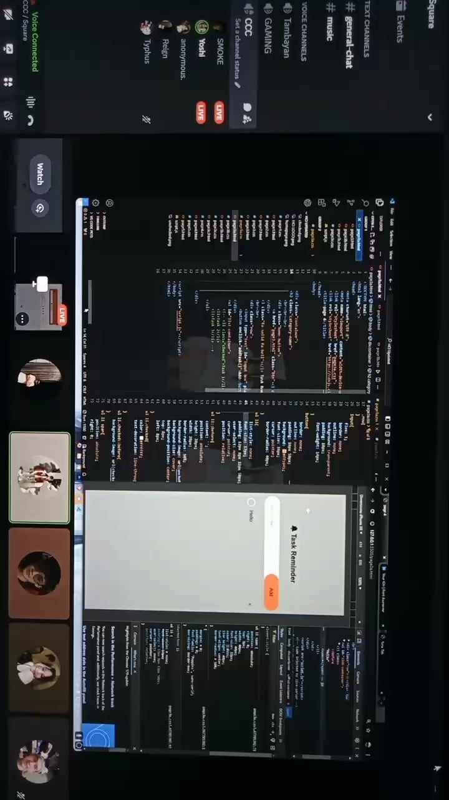
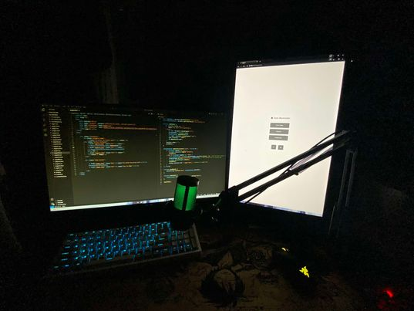
CODING

Slide 10
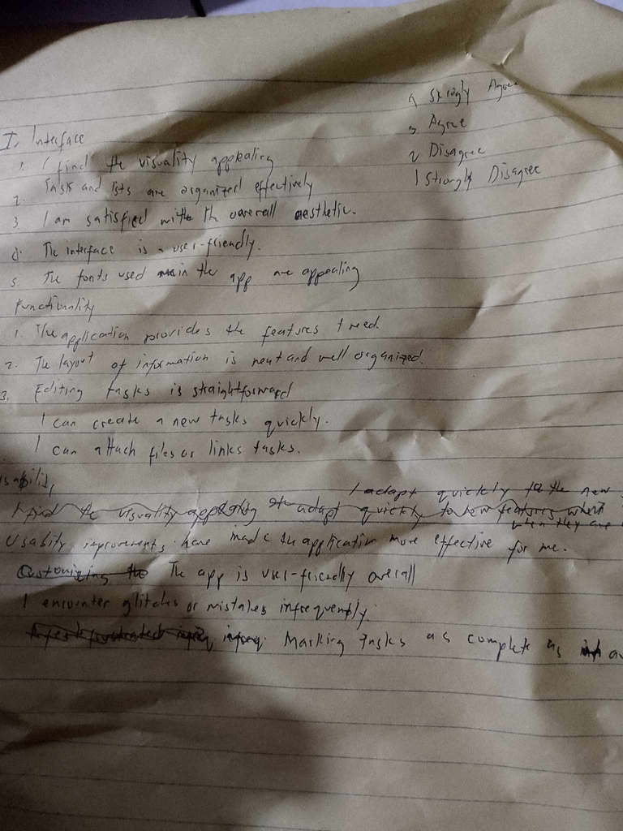
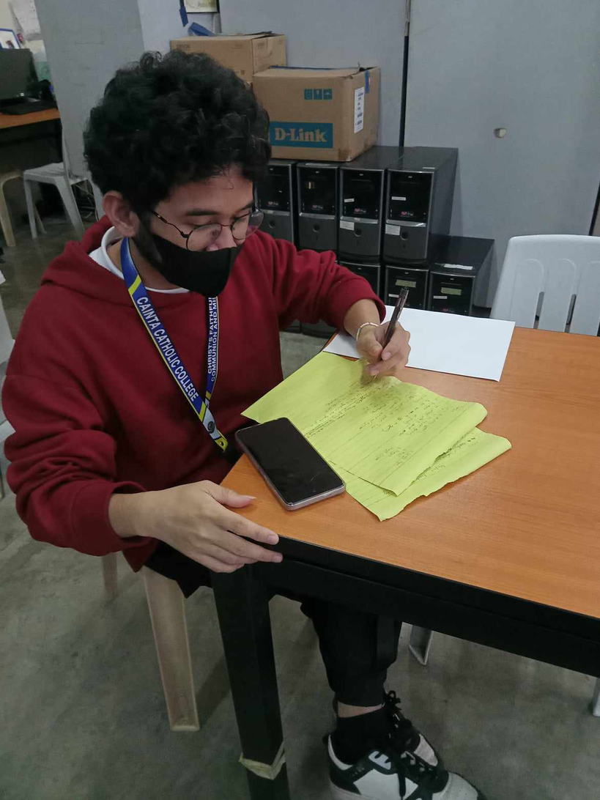
CHECKING OF SURVEY QUESTIONNAIRE

Slide 11
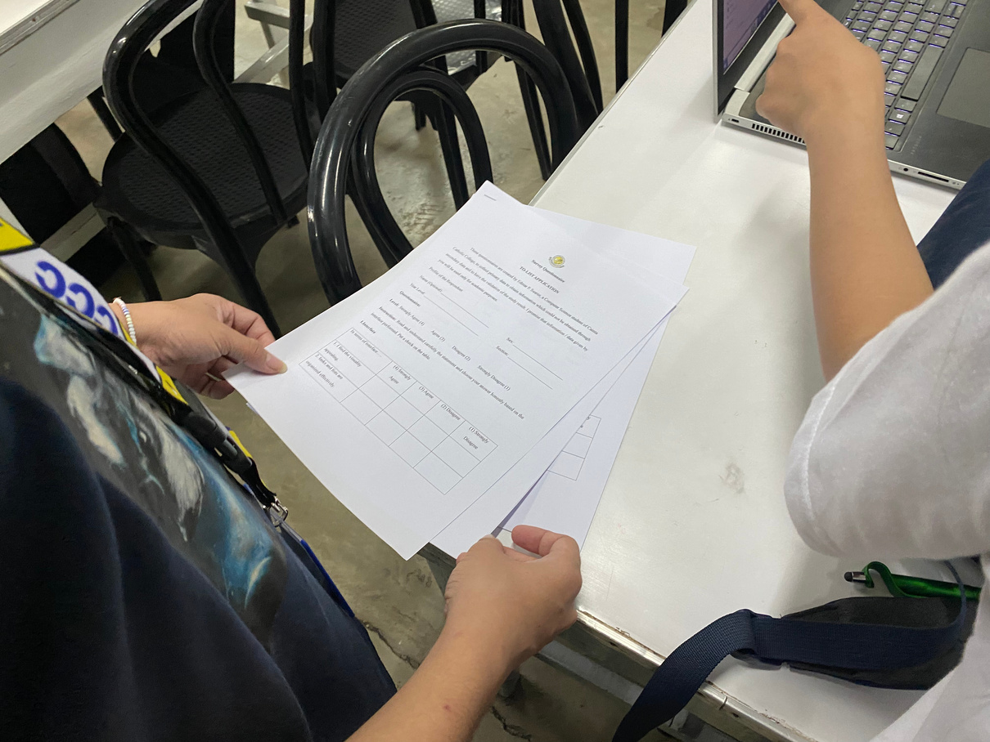
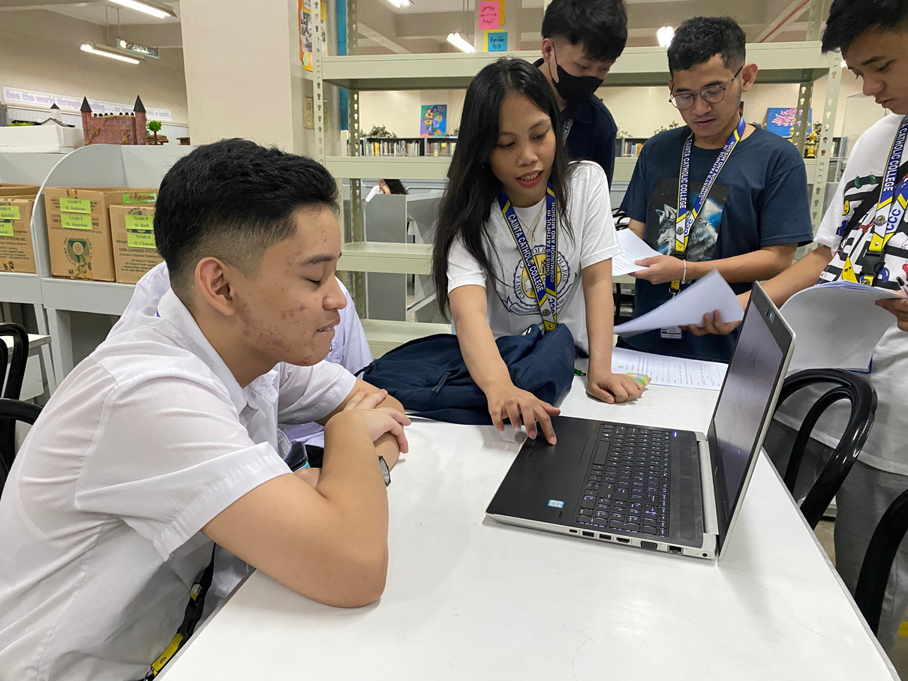
SURVEY

Slide 12

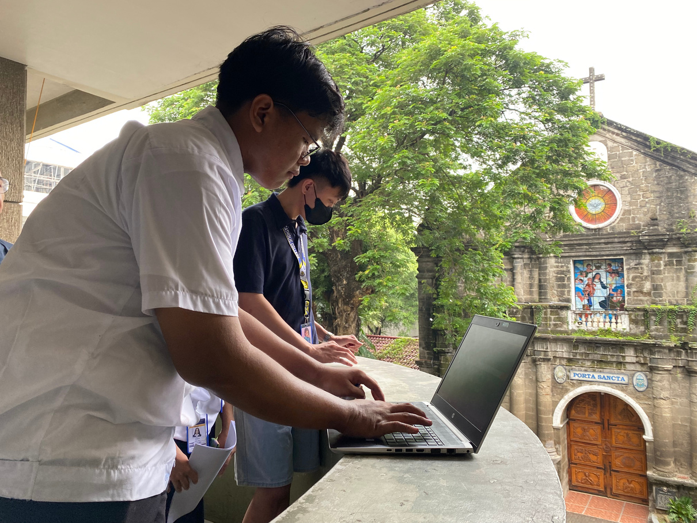
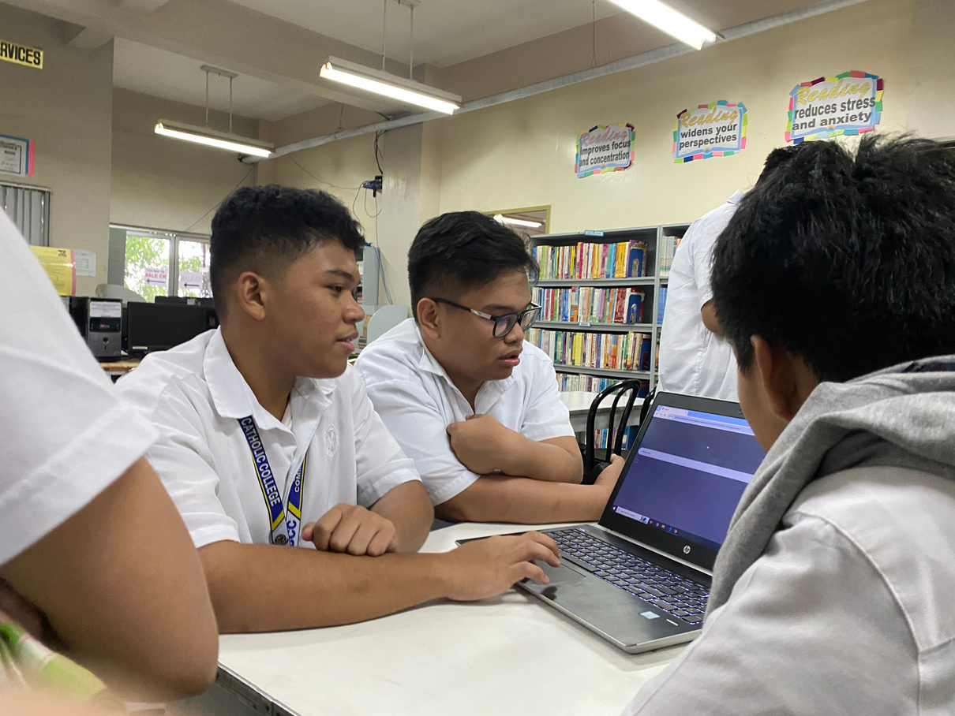
SURVEY

Slide 13
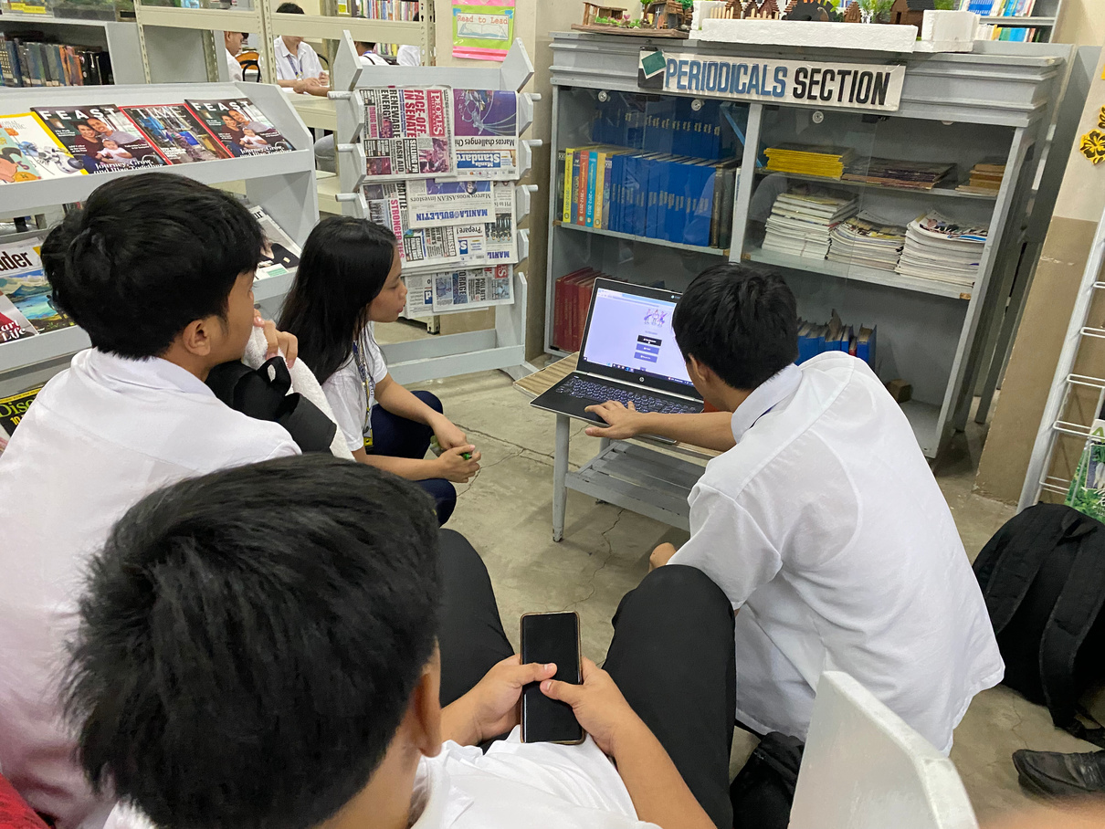
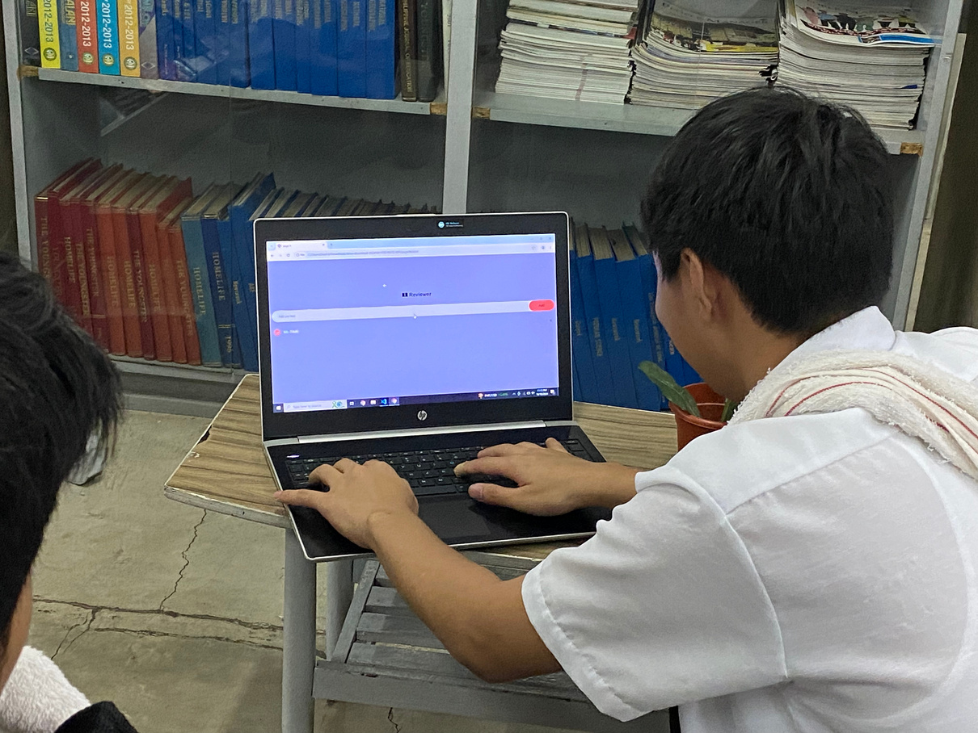
SURVEY

Slide 14
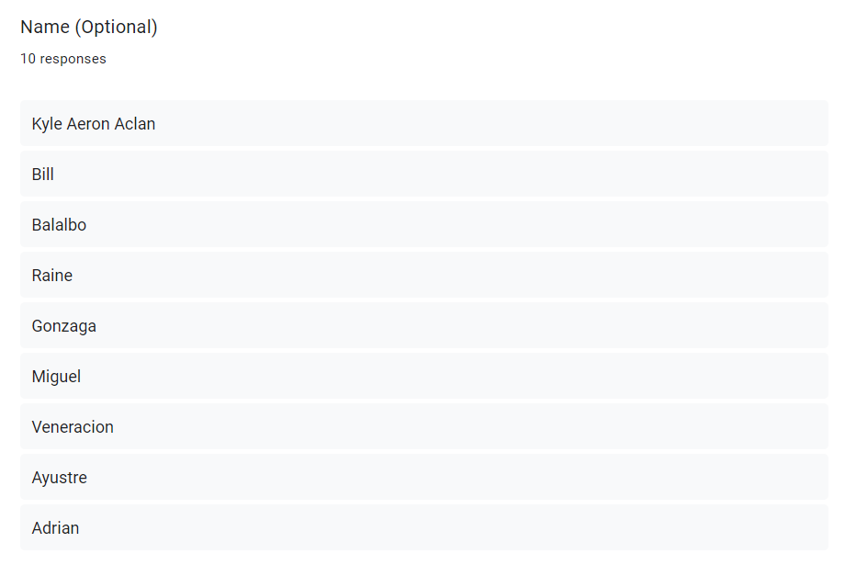
RESULT OF THE SURVEY
PROFILE OF THE RESPONDENTS
In figure 1, the 10 students put their names, and the 5 students didn’t put their names.
Figure 1

Slide 15
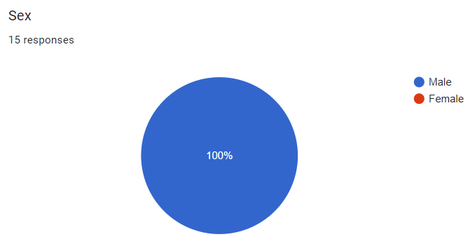
RESULT OF THE SURVEY
PROFILE OF THE RESPONDENTS
In figure 2, 15 male students answer the survey.
Figure 2

Slide 16
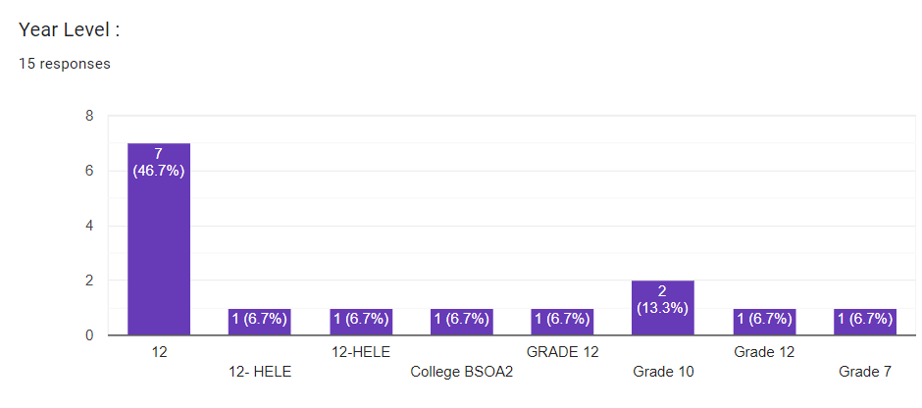
RESULT OF THE SURVEY
PROFILE OF THE RESPONDENTS
In figure 3, there are 11 respondents from grade 12, 2 respondents from grade 10, 1 respondent from grade 7, and 1 respondent from college.
Figure 3

Slide 17
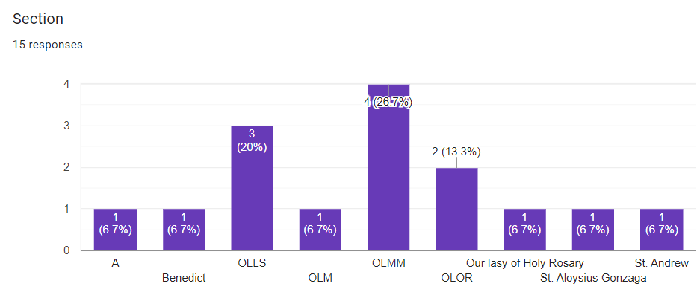
RESULT OF THE SURVEY
PROFILE OF THE RESPONDENTS
In figure 4, from section A (BSOA-2A) there’s 1 respondent, in section Benedict there’s 1 respondent, in OLLs there’s 3 respondents, in OLM there’s 1 respondent, in OLMM there’s 4 respondents, in OLOR there’s 2 respondent, in OLHR there’s 1 respondent, in St. Aloysius Gonzaga there’s 1 respondent, and in St. Andrew there’s 1 respondent.
Figure 4

Slide 18
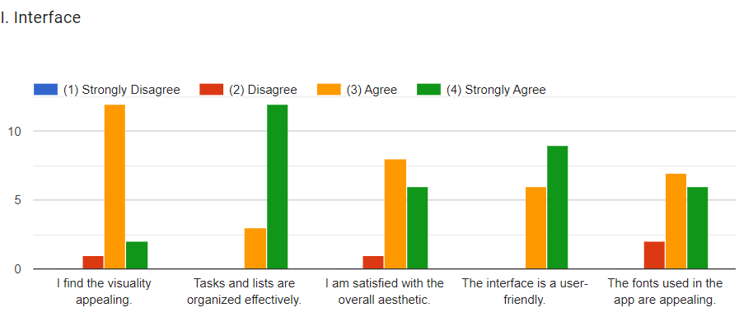
RESULT OF THE SURVEY
QUESTIONNAIRES
Figure 5

Slide 19
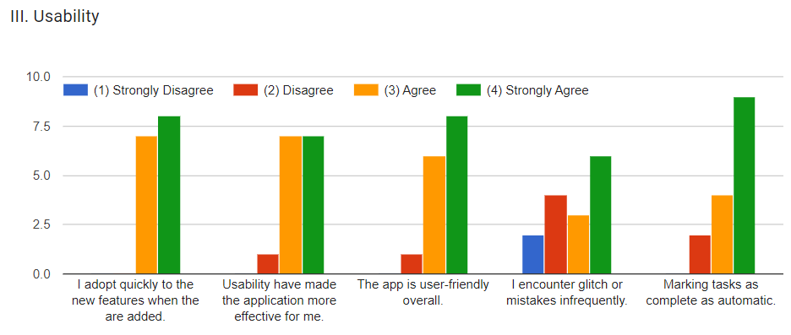
RESULT OF THE SURVEY
QUESTIONNAIRES
Figure 7

Slide 20
RESULT OF THE SURVEY
QUESTIONNAIRES
Figure 7

Slide 21
THANK YOU!

